Slide 1
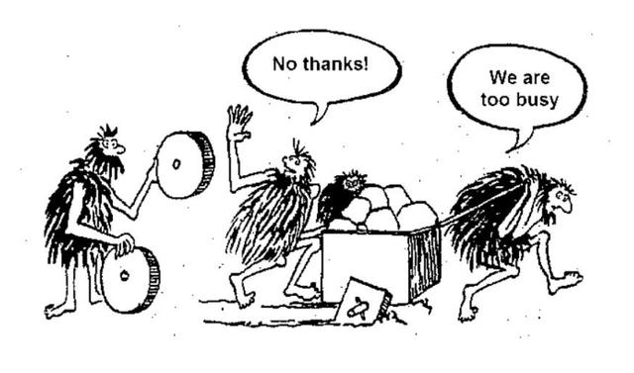
Reuse Library
Don't reinvent the wheel
E2M Virtual Team
April 2023

Slide 2





Value Proposition
High-Performance Org
Trust Technical Partner
Increase development efficiency & establish reusable mindset
Demo strong technical capability & build reputation with customer
Talent Development
Customer Loyalty
Enhance programing skills & concept of CI/CD
Accelerate project delivery & enrich NI/LabVIEW Ecosystem
Notes:
Internal:
Talent Development
Library Reusable & ROI
Cultivate a High-Performance Organization
External: (Vision), to customer and partners
Trust Technical Partner
Accelerate Project Delivery
NI Ecosystem & Customer Loyalty

Slide 3






Current State & Benefited Projects
Satellite Communication Platform
CNS FPT Project
APT MAL/HAL Project
Multi-channles DAQ Project
OpenLab
Development Environment
Basic Function
Application Framework
LabVIEW Version Selector
LabVIEW QuickDrops Manager
SimpleGit-Provider
LvCICD
3rd Partry Dependencies
Programming Palette
TagDB Library
TagDB Reference Manager Lib
TagDB Configuration UI Frame
LabVIEW X Controls
Xilinx Virtual Cable In Vivado
LabVIEW Stop Signal
LabVIEW Global Stop Library
LabVIEW MassData Smart Ptr
ZMQ Protocol Interface
Multi-Chns-Sdk-Comm
Reuse Lib

Slide 4
Execution Plan & Deliverables
Resource:
Estimated effort: 150Hrs, ~10% bandwidth
Songxiang Liu, Zihao Wei, Yu Feng, Tong Li(Lead) + Anyone who interested
Consultant: Yao Li, Chen Chen
Work Scope:
2023 Q2: Focus on improving existing libraries
Deliverables:
Reuse libraries
Some best practice

Slide 5
Appendix

Slide 6
Group | Library Name | Description | Latest Version | Repository | Release As | Project Referred
Programming Environments | LabVIEW Version Selector | Useful tool if you have multiple LabVIEW Versions installed. | 2.0.0.40 | NEVSTOP-LAB/LabVIEW-Version-Selector: Select the correct LabVIEW version for project. | vipm | Development Tool, All computers with multiple LabVIEW versions installed are recommended to install this library.
 | LabVIEW QuickDrops Manager | A shortcut dialog to manage all quick drops | v2022.11.9 | NEVSTOP-LAB/LabVIEW-QuickDrops-Manager: Tool for managing your QuickDrops. | vipm | Development Tool. Recommend to install with LabVIEW.
 | SimpleGit-Provider | Integrate tortoisegit dialogs to left click menu in LabVIEW project tree. | v2022.10.23.6 | NEVSTOP-LAB/SimpleGit-Provider: Simple git provider for LVAPT daily workflow. | vipm | Development Tool. Recommend to install with LabVIEW if git is used in workflow.
Supplement of Basic Functions | NEVSTOP-3rdParty-Dependencies | 3rd-party dependencies collection for most frequency usage in LabVIEW development. | v2022.12.28 | NEVSTOP-LAB/NEVSTOP-3rdParty-Dependencies: 3rd-party dependencies of NEVSTOP Lab Libraries | vipm | APT Demo / any project Yao/Tong/Yongtao participated
 | NEVSTOP-Programming-Palette | Supplement of Basic Functions for daily programming. | v2023.04.01 | NEVSTOP-LAB/NEVSTOP-Programming-Palette | vipm | APT Demo / any project Yao/Tong/Yongtao participated
Framework of Application | LabVIEW TagDB Library LabVIEW TagDB Reference Manager Library LabVIEW TagDB Configuration UI Frame | This library sets are used to manage tag/configuration data in large applications. It could also manage the front panel references and provide a shortcut Vis for UI refreshing, State Changing and Standard configuration dialogs. | 2.0.1.1 (3.0 in dev for LabVIEW 2017+ with vim feature) | LabVIEW Libraries from NEVSTOP | vipm | APT Projects for AVIC,CASC / CNS Projects for CASC, CASIC
 | LabVIEW-Stop-Signal | This library provides the exit mechanism for large application. Application could stop its modules/components by starting orders or any strategy needed. It provides signal check, stop use event for both Event structure-based loop and background thread loop for multiple scenarios. | v2022.12.13 | NEVSTOP-LAB/LabVIEW-Stop-Signal: LabVIEW 架构可使用的停止方案 | vipm | APT Projects for AVIC,CASC / CNS Projects for CASC, CASIC
 | LabVIEW-GlobalStop-Library | Simple version of exit mechanism for small or medium scale project. | v2022.12.12 | NEVSTOP-LAB/LabVIEW-GlobalStop-Library: Simple stop mechanism for parallel loops in LabVIEW | vipm | CNS Projects for CASC, CASIC
 | LabVIEW-MassData-Smart-Ptr | Provide smart pointer for large memory data(waveform/DBL Array) to make it possible for sending with message in DQMH/Actor Framework. | v2022.12.15 | NEVSTOP-LAB/LabVIEW-MassData-Smart-Ptr (github.com) | vipm | Multi-Channel DAQ Project for CASIC
CI/CD | LvCICD | This repo is used to complete the missing part of LabVIEW operations in Continuous integration and continuous deployment(CI/CD). | v0.6 | LV-APT/lvCICD: Customer Action for LabVIEW CI/CD | GitHub-Action | APT Demo/OpenLab
UI | LabVIEW X-Controls | Provides examples and customized x-control. | N/A | NEVSTOP-LAB/LabVIEW-UI-XCtl: LabVIEW XControls for UI | Source-code | POC
Application Scenario | ZMQ-Protocol-Interface | This repo provides a template of network communication layer for LabVIEW application, to help stand-alone application receive command and publish its status in network. ZMQ is used as the network protocol. This library provide functions of flattening most of the common datatypes to make sure any other language could parse it. The best practice for this library is used with DQMH framework. It’s optimized to reduce changes needed for adding the network communication layer. | 0.2.1 | Private | vipm | Satellite communication prototype for Pengcheng Lab

Slide 7
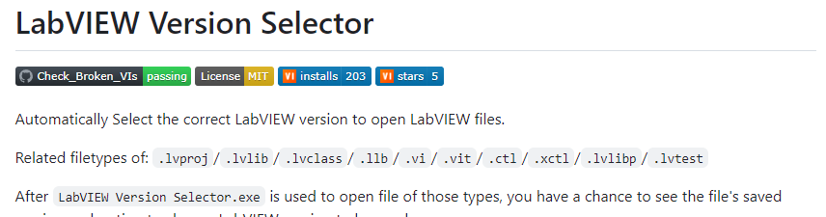
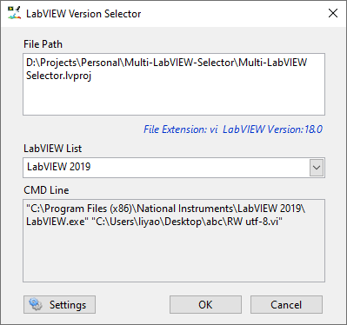
LabVIEW Version Selector
Programming Environments
Library Name | LabVIEW Version Selector
Description | Useful tool if you have multiple LabVIEW Versions installed.
Latest Version | 2.0.0.40
Repository | NEVSTOP-LAB/LabVIEW-Version-Selector: Select the correct LabVIEW version for project. (github.com)
Release As | vipm
Download link | LabVIEW-Version-Selector Toolkit for LabVIEW - Download - VIPM by JKI
Dependencies | LabVIEW 2014+ VIPM 2020.3 OpenG Libraries JKI State Machine
Project Referred | Development Tool, All computers with multiple LabVIEW versions installed are recommended to install this library.

Slide 8
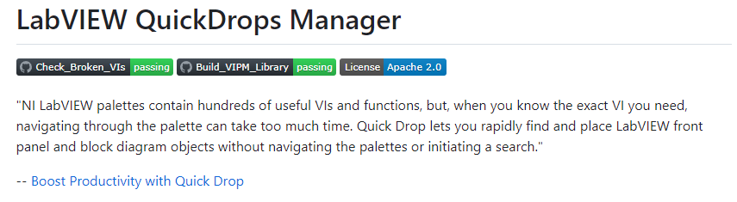
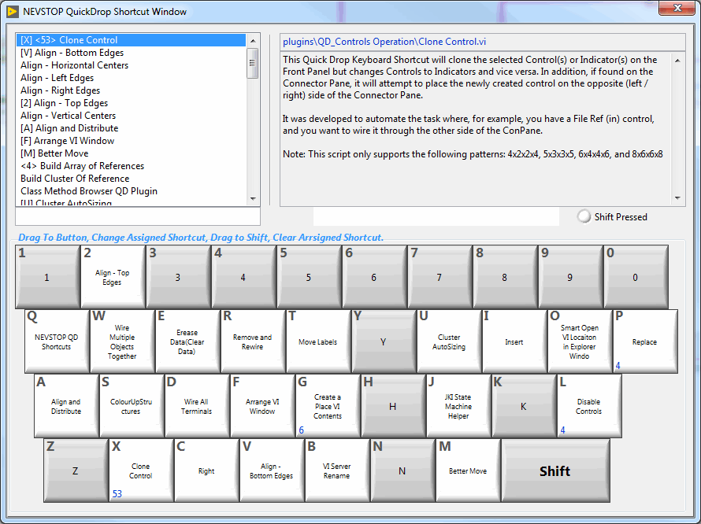
LabVIEW QuickDrops Manager
Programming Environments
Library Name | LabVIEW QuickDrops Manager
Description | A shortcut dialog to manage all quick drops
Latest Version | v2022.11.9
Repository | NEVSTOP-LAB/LabVIEW-QuickDrops-Manager: Tool for managing your QuickDrops. (github.com)
Release As | vipm
Download link | Release v2022.11.9 · NEVSTOP-LAB/LabVIEW-QuickDrops-Manager (github.com)
Dependencies | LabVEW 2014+ VIPM 2020.3 OpenG Libraries MGI Libraries JKI State Machine
Project Referred | Development Tool. Recommend to install with LabVIEW.

Slide 9
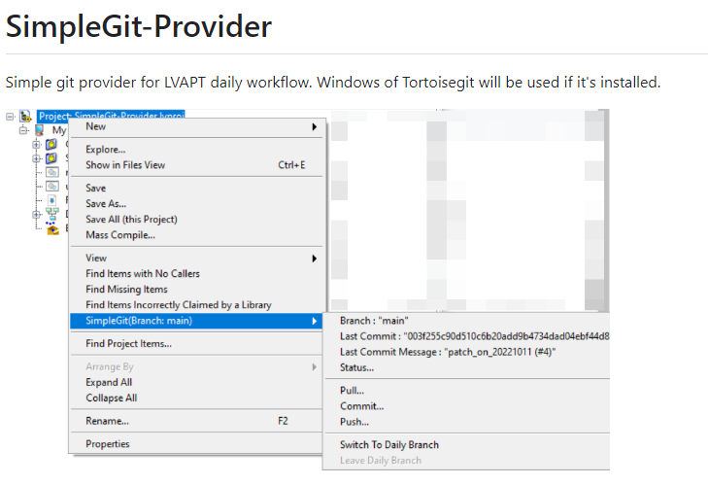
SimpleGit-Provider
Programming Environments
Library Name | SimpleGit-Provider
Description | Integrate tortoisegit dialogs to left click menu in LabVIEW project tree.
Latest Version | v2022.10.23.6
Repository | NEVSTOP-LAB/SimpleGit-Provider: Simple git provider for LVAPT daily workflow. (github.com)
Release As | vipm
Download link | https://github.com/NEVSTOP-LAB/SimpleGit-Provider/releases/tag/simplegit_provider-2022.10.23.6
Dependencies | Git API OpenG Libraries Tortoisegit Automating TortoiseGit
Project Referred | Development Tool. Recommend to install with LabVIEW if git is used in workflow.

Slide 10
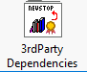
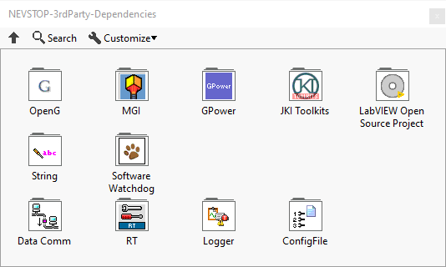
NEVSTOP-3rdParty-Dependencies
Supplement of Basic Functions
Library Name | NEVSTOP-3rdParty-Dependencies
Description | 3rd-party dependencies collection for most frequency usage in LabVIEW development.
Latest Version | v2022.12.28
Repository | NEVSTOP-LAB/NEVSTOP-3rdParty-Dependencies: 3rd-party dependencies of NEVSTOP Lab Libraries (github.com)
Release As | vipm
Download link | https://github.com/NEVSTOP-LAB/NEVSTOP-3rdParty-Dependencies/releases/tag/v2022.12.28
Dependencies | N/A
Project Referred | APT Demo / any project Yao/Tong/Yongtao participated

Slide 11
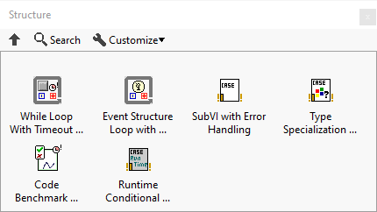
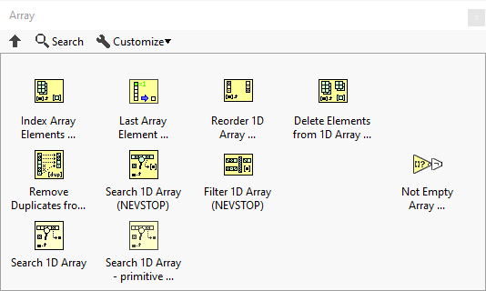
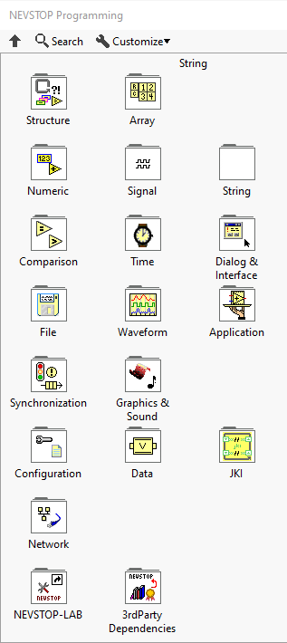
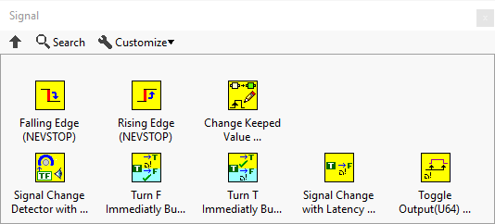
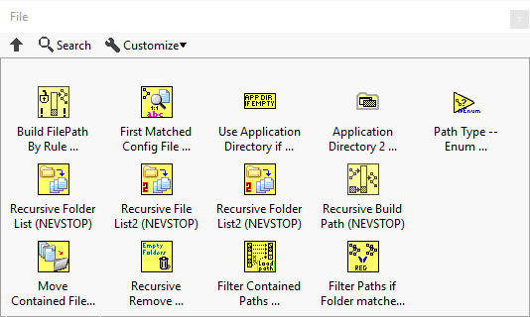
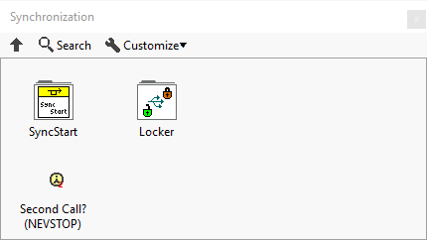
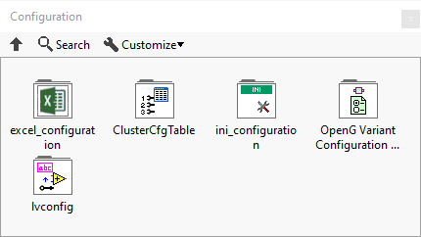
NEVSTOP-Programming-Palette
Supplement of Basic Functions
Library Name | NEVSTOP-Programming-Palette
Description | Supplement of Basic Functions for daily programming.
Latest Version | v2023.04.01
Repository | NEVSTOP-LAB/NEVSTOP-Programming-Palette: 用于补充 LabVIEW 日常编程使用的常用VI (github.com)
Release As | vipm
Download link | https://github.com/NEVSTOP-LAB/NEVSTOP-Programming-Palette/releases/tag/v2023.04.01
Dependencies | N/A
Project Referred | APT Demo / any project Yao/Tong/Yongtao participated

Slide 12
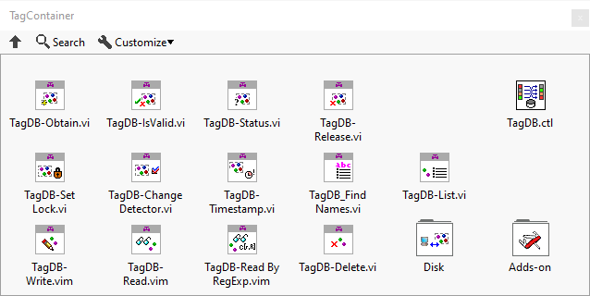
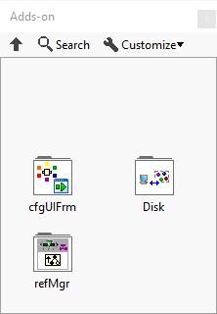
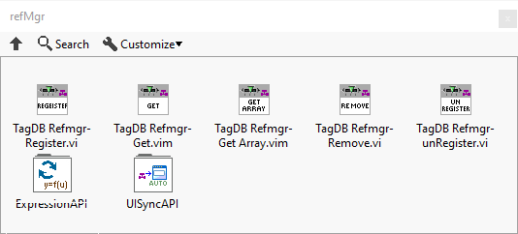
Tag DB Library – Tag/Configuration/UI Management
Framework of Application
Library Name | LabVIEW TagDB Library LabVIEW TagDB Reference Manager Library LabVIEW TagDB Configuration UI Frame
Description | This library sets are used to manage tag/configuration data in large applications. It could also manage the front panel references and provide a shortcut Vis for UI refreshing, State Changing and Standard configuration dialogs.
Latest Version | 2.0.1.1 (3.0 in dev for LabVIEW 2017+ with vim feature)
Repository | LabVIEW Libraries from NEVSTOP (github.com)
Release As | vipm
Download link | private
Dependencies | N/A
Project Referred | APT Projects for AVIC,CASC / CNS Projects for CASC, CASIC

Slide 13
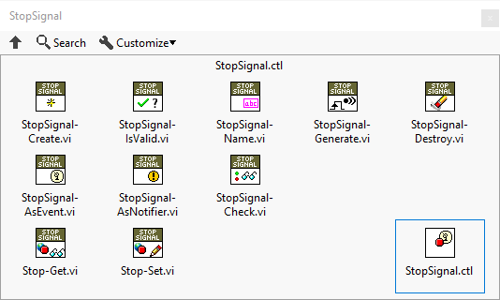
LabVIEW-Stop-Signal – Exit Mechanism
Framework of Application
Library Name | LabVIEW-Stop-Signal
Description | This library provides the stop mechanism for large application. Application could stop its modules/components by starting orders or any strategy needed. It provides signal check, stop use event for both Event structure-based loop and background thread loop for multiple scenarios.
Latest Version | v2022.12.13
Repository | NEVSTOP-LAB/LabVIEW-Stop-Signal: LabVIEW 架构可使用的停止方案 (github.com)
Release As | vipm
Download link | Release v2022.12.13 · NEVSTOP-LAB/LabVIEW-Stop-Signal (github.com)
Dependencies | N/A
Project Referred | APT Projects for AVIC,CASC

Slide 14
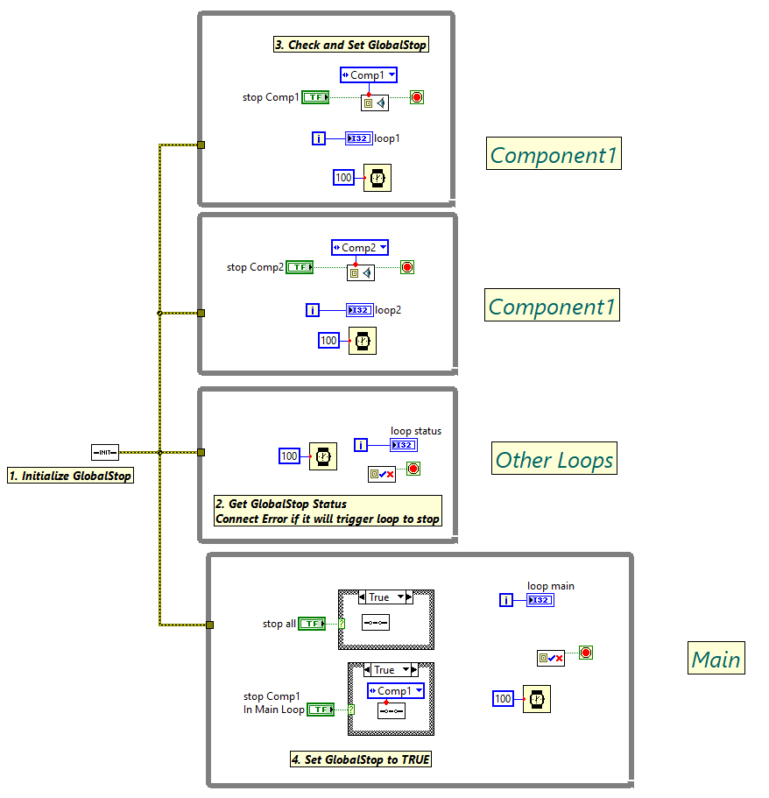
LabVIEW GlobalStop Library – Exit Mechanism
Framework of Application
Library Name | LabVIEW-GlobalStop-Library
Description | Simple version of stopping mechanism for small or medium scale project.
Latest Version | v2022.12.12
Repository | NEVSTOP-LAB/LabVIEW-GlobalStop-Library: Simple stop mechanism for parallel loops in LabVIEW (github.com)
Release As | vipm
Download link | https://github.com/NEVSTOP-LAB/LabVIEW-GlobalStop-Library/releases/tag/v2022.12.12
Dependencies | N/A
Project Referred | CNS Projects for CASC, CASIC

Slide 15
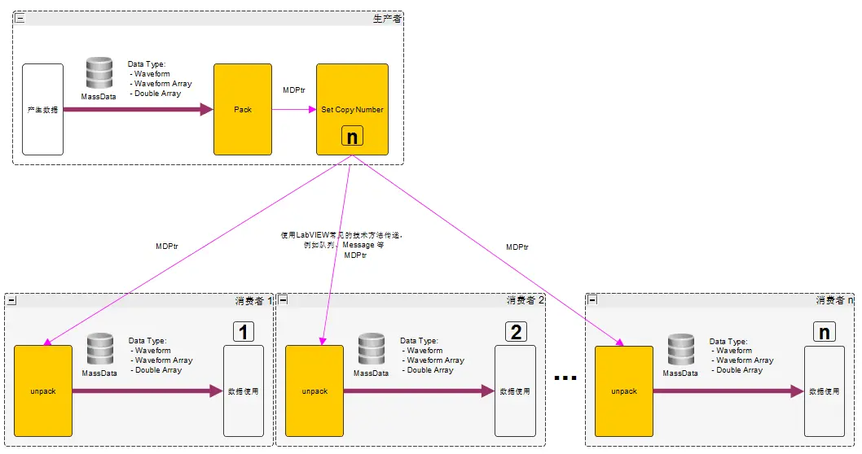
LabVIEW-MassData-Smart-Ptr – Streaming Data
Framework of Application
Library Name | LabVIEW-MassData-Smart-Ptr
Description | Provide smart pointer for large memory data(waveform/DBL Array) to make it possible for sending with message in DQMH/Actor Framework.
Latest Version | v2022.12.15
Repository | NEVSTOP-LAB/LabVIEW-MassData-Smart-Ptr (github.com)
Release As | vipm
Download link | https://github.com/NEVSTOP-LAB/LabVIEW-MassData-Smart-Ptr/releases/tag/v2022.12.15
Dependencies | N/A
Project Referred | Multi-Channel DAQ Project for CASIC

Slide 16
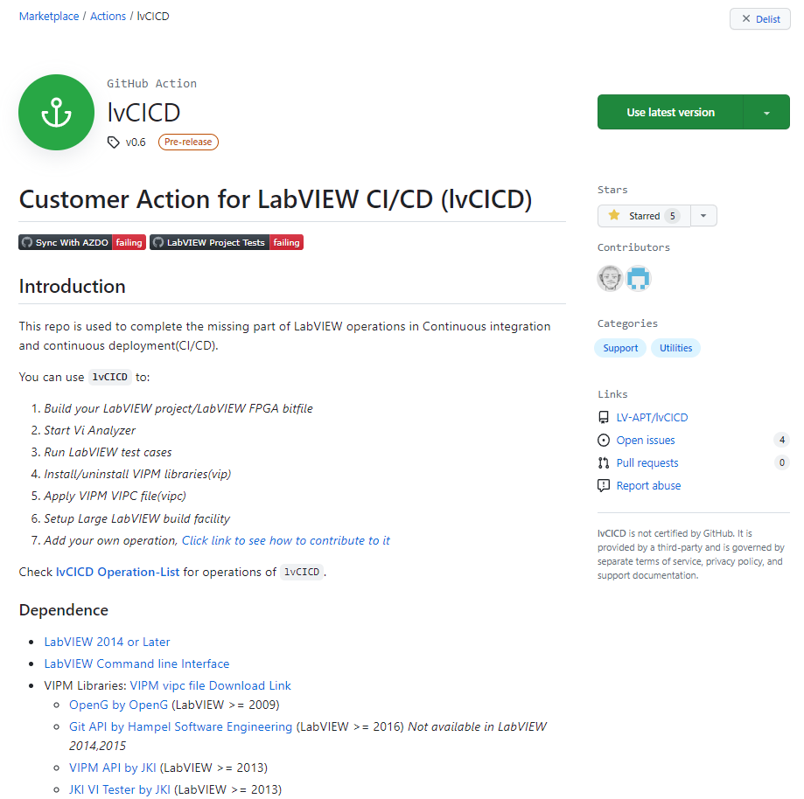
LvCICD - Customer Action for LabVIEW CI/CD (lvCICD)
Continuous Integration and Continuous Deployment(CI/CD)
Library Name | lvCICD
Description | This repo is used to complete the missing part of LabVIEW operations in Continuous integration and continuous deployment(CI/CD).
Latest Version | v0.6
Repository | LV-APT/lvCICD: Customer Action for LabVIEW CI/CD (github.com)
Release As | Github Action
Download link | lvCICD · Actions · GitHub Marketplace
Dependencies | LabVIEW 2014 or Later LabVIEW Command line Interface VIPM Libraries: VIPM vipc file Download Link OpenG by OpenG (LabVIEW >= 2009) Git API by Hampel Software Engineering (LabVIEW >= 2016) Not available in LabVIEW 2014,2015 VIPM API by JKI (LabVIEW >= 2013) JKI VI Tester by JKI (LabVIEW >= 2013)
Project Referred | APT Demo/OpenLab

Slide 17
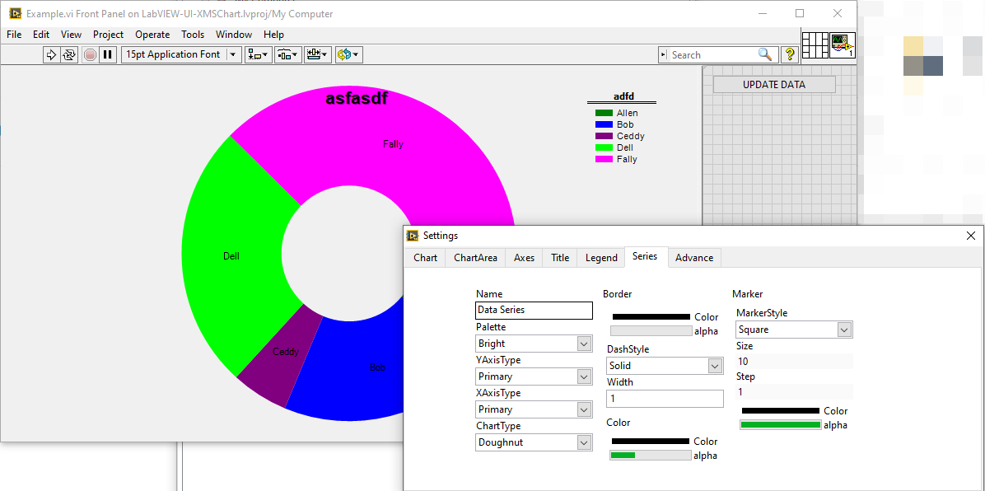
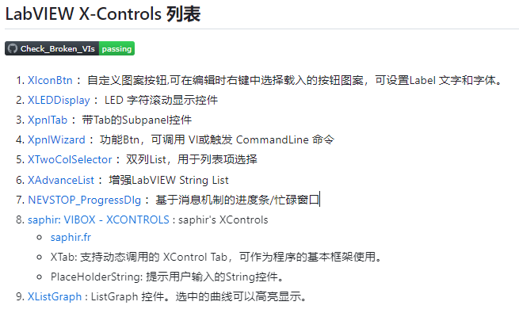
LabVIEW X-Controls
UI
Library Name | LabVIEW X-Controls
Description | Provides examples and customized x-control.
Latest Version | N/A
Repository | NEVSTOP-LAB/LabVIEW-UI-XCtl: LabVIEW XControls for UI (github.com)
Release As | Source Code for LabVIEW 2014+
Download link | https://github.com/NEVSTOP-LAB/LabVIEW-UI-XCtl
Dependencies | OpenG
Project Referred | POC

Slide 18
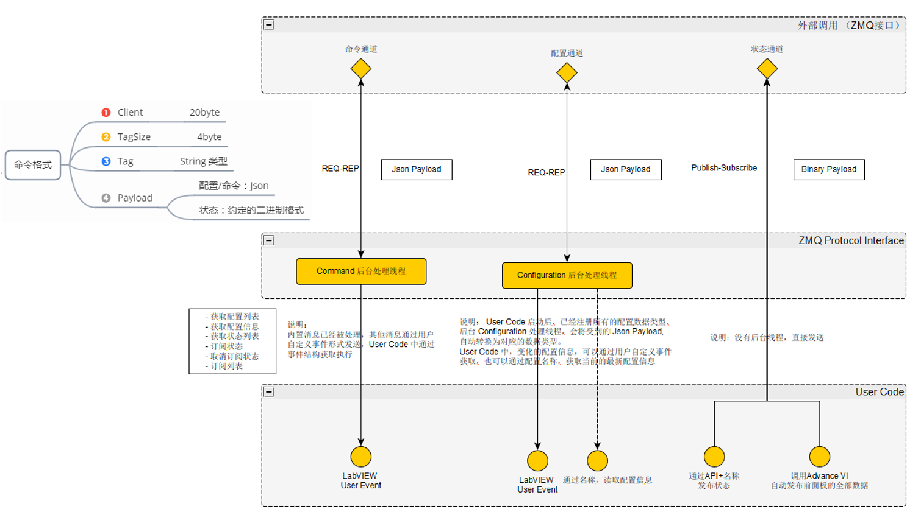
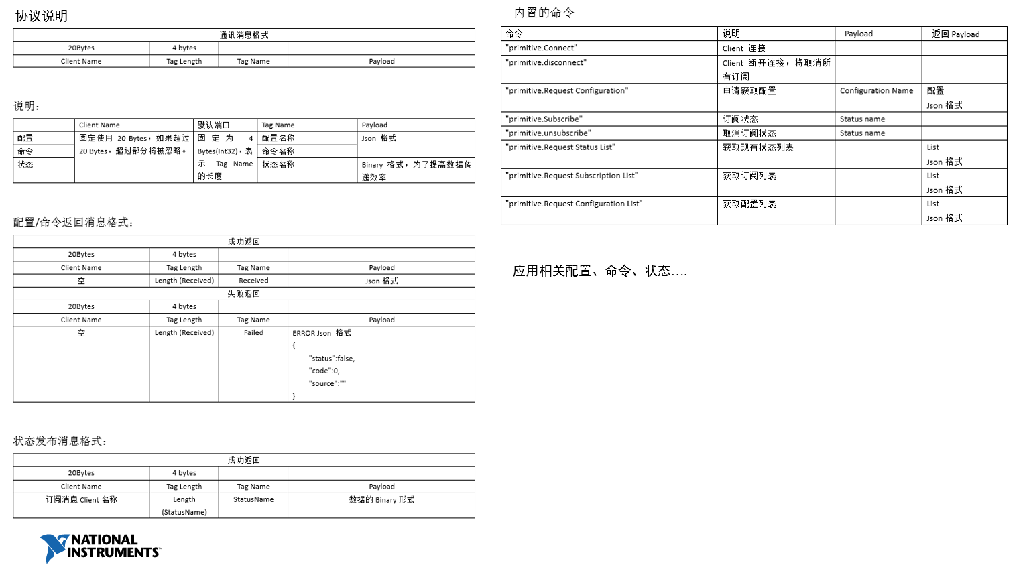
ZMQ-Protocol-Interface
Application Scenario
Library Name | ZMQ-Protocol-Interface
Description | This repo provides a template of network communication layer for LabVIEW application, to help stand-alone application receive command and publish its status in network. ZMQ is used as the network protocol. This library provide functions of flattening most of the common datatypes to make sure any other language could parse it. The best practice for this library is used with DQMH framework. It’s optimized to reduce changes needed for adding the network communication layer.
Latest Version | 0.2.1
Repository | Private
Release As | vipm
Download link | Private, communicate to get it.
Dependencies | OpenG ZMQ Library
Project Referred

Slide 19
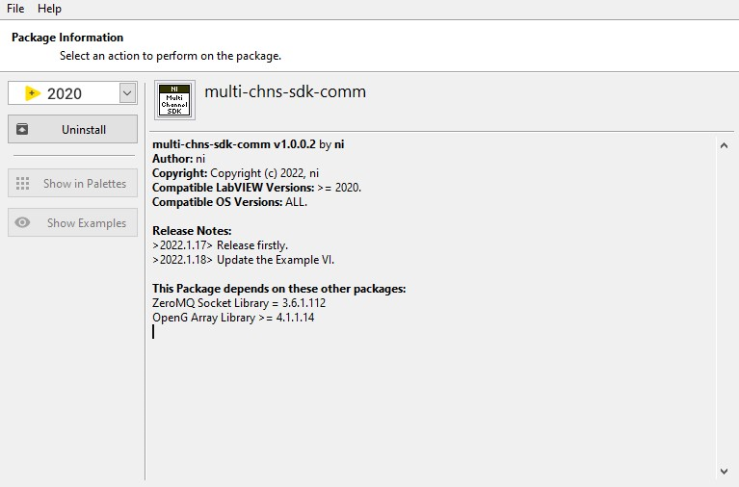
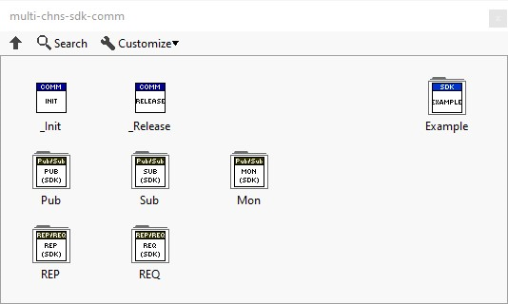
Multi-Chns-Sdk-Comm
Application Scenario
Library Name | multi-chns-sdk-comm
Description | Data communication library based on zeromq, The library is cross-platform and can be used both on Windows and LinuxRT. It supports Pub-Sub pattern and Rep-Reply pattern and can be used to build a distributed data/command data path easily.
Latest Version | 1.0.0.7
Repository | Private
Release As | vipm
Download link | Private, communicate to get it.
Dependencies | OpenG labview-zmq-3.5.1.109+
Project Referred | It is currently used by multichannel DAQ project

Slide 20
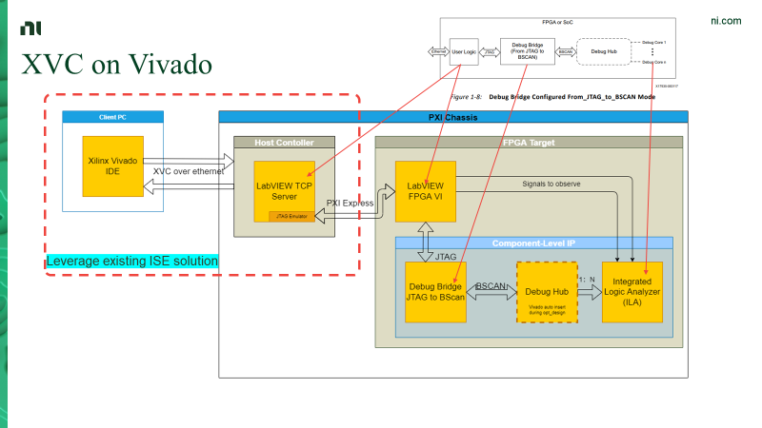
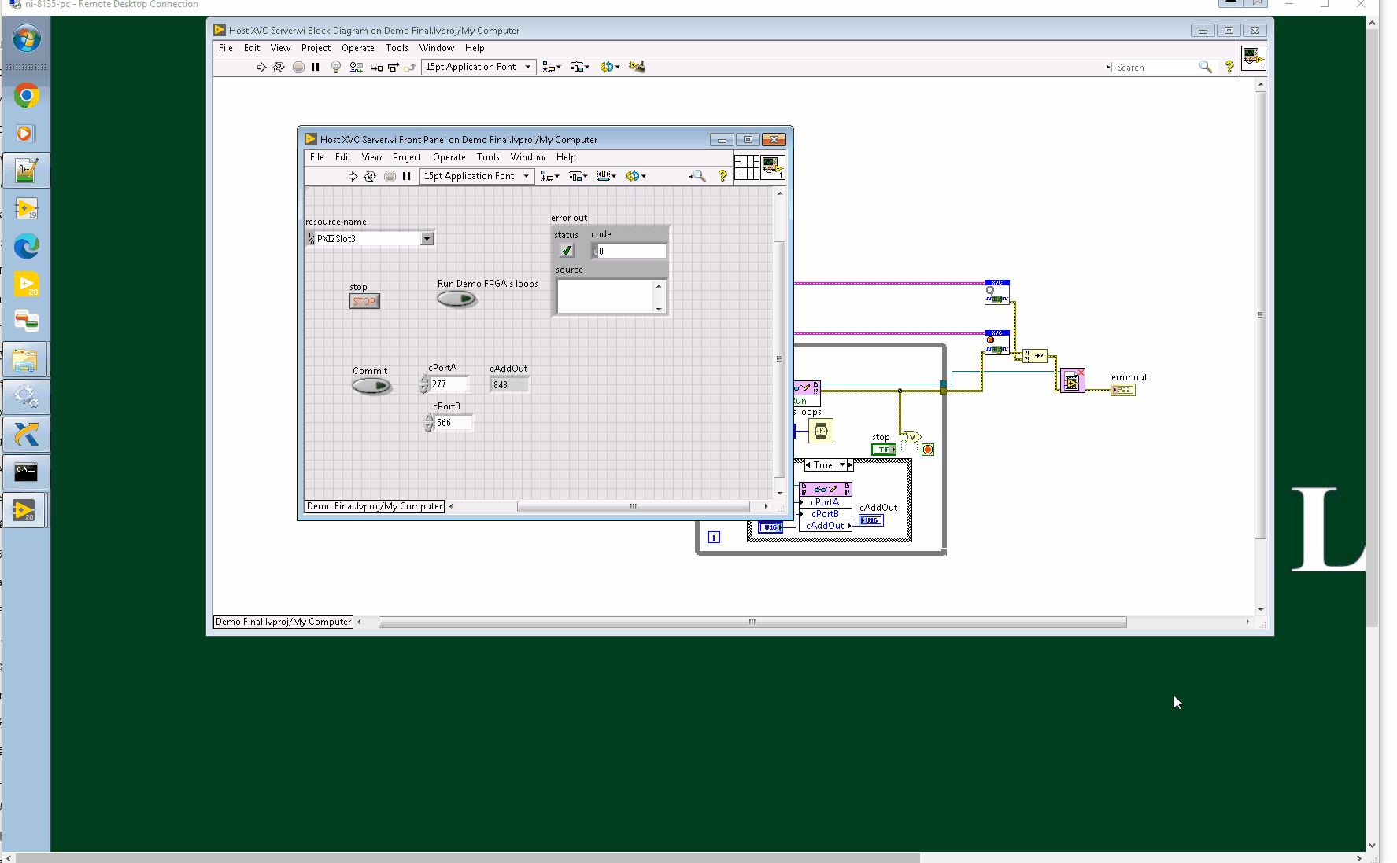
Xilinx Virtual Cable In Vivado
Proof-Of-Concept
Library Name | Xilinx-virtual-cable-Vivado
Description | A proof-of-concept demo for Xilinx Virtual Cable in Vivado to help ease the pain of FPGA on-chip debugging and support remote debugging of FPGA. It includes three parts: - A host lib work as XVC server A CLIP template and Vivado project to generate netlist A LabVIEW provider to demonstrate one-click CLIP generation
Latest Version | N/A
Repository | Internal
Release As | LabVIEW project
Download link | https://dev.azure.com/ni/Users/_git/cchen-xvc-demo
Dependencies | Xilinx Vivado
Project Referred | Internal Demo only

